Slide 1
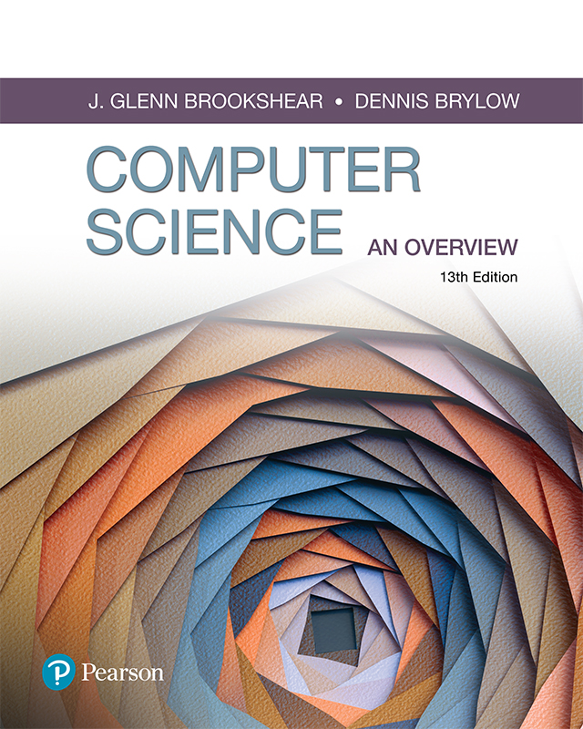
Computer Science An Overview
13th Edition
Chapter 0
Introduction

Slide 2
Chapter 0: Introduction
0.1 The Role of Algorithms
0.2 The History of Computing
0.3 An Outline of Our Study
0.4 The Overarching Themes of Computer Science
Algorithms
Abstraction
Creativity
Data
Programming
Internet
Impact

Slide 3
0.1 The Role of Algorithms
Algorithm: A set of steps that defines how a task is performed
Program: A representation of an algorithm
Programming: The process of developing a program
Software: Programs and the algorithms they represent
Hardware: The machinery

Slide 4
Figure 1 Algorithm to determine an average test score.
Description:
This algorithm assumes that its input consists of 5 positive integers and proceeds to compute the average of these 5 values.
Procedure:
Step 1. Get the five test scores.
Represent the five values as score1, score2, score3, score4, score5.
Step 2. Add the five test scores (score1+score2+score3+score4+score5).
Represent the value as sum.
Step 3. Divide the sum by the number of scores input. (sum/5).

Slide 5
History of Algorithms
The study of algorithms was originally a subject in mathematics.
Early examples of algorithms
Long division algorithm
ref: https://en.wikipedia.org/wiki/Long_division (under “Method”, look at example and then the breakdown of steps that follows)
Euclidean Algorithm (computing GCD of 2 integers)
ref: https://en.wikipedia.org/wiki/Euclidean_algorithm (under “Description” read the “Procedure” portion for the step process)
Gödel's Incompleteness Theorem
Says that some problems cannot be solved by algorithms - that the ability to find a complete and consistent set of axioms for all mathematics is impossible.
ref: https://en.wikipedia.org/wiki/G%C3%B6del%27s_incompleteness_theorems

Slide 6
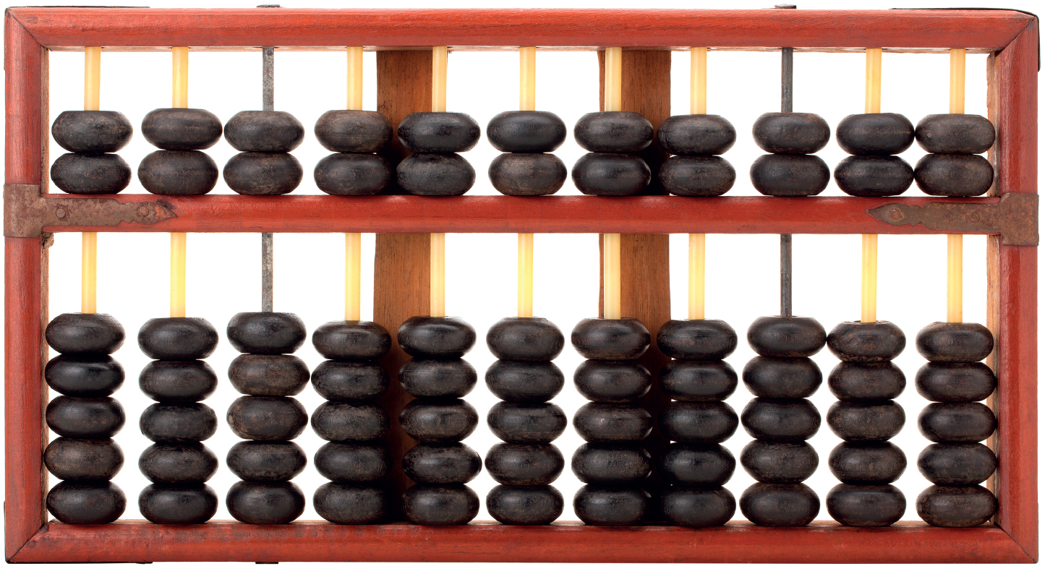
0.2 The History of Computing
Early computing devices
Abacus: positions of beads represent numbers
Gear-based machines (1600s-1800s)
Positions of gears represent numbers
Blaise Pascal, Wilhelm Leibniz, Charles Babbage
Chinese Wooden Abacus

Slide 7
Early Data Storage
Punched cards
First used in Jacquard Loom (1801) to store patterns for weaving cloth
Storage of programs in Babbage’s Analytical Engine
Popular through the 1970’s
Gear positions

Slide 8
Early Computers
Based on mechanical relays
1940: Stibitz at Bell Laboratories
1944: Mark I: Howard Aiken and IBM at Harvard
Based on vacuum tubes
1937-1941: Atanasoff-Berry at Iowa State
1940s: Colossus: secret German code-breaker
1940s: ENIAC: Mauchly & Eckert at U. of Penn.

Slide 9
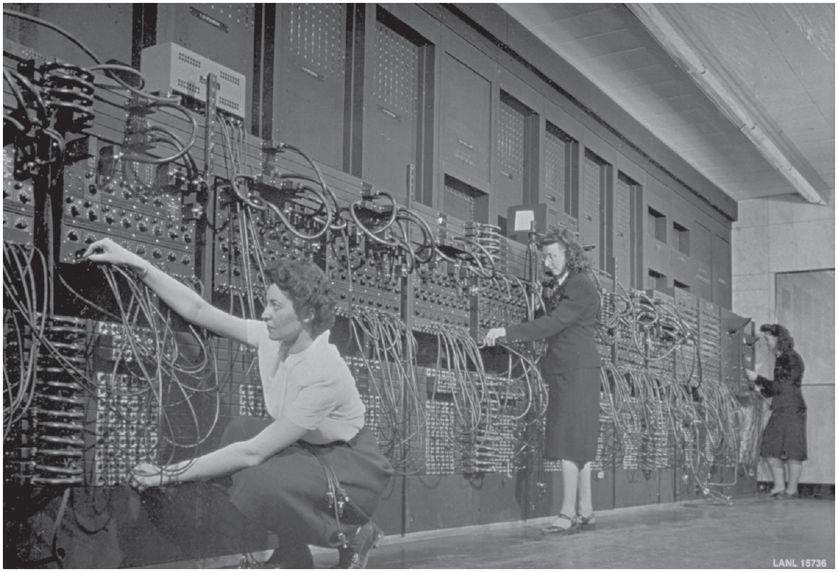
Figure 2 Three women operating the ENIAC’s main control panel

Slide 10
Personal Computers
Hobbyists built homemade computers
Apple Computer established in 1976.
IBM introduced the PC in 1981.
Accepted by business
Became the standard hardware design for most desktop computers
Most PCs use software from Microsoft

Slide 11
End of the 20th Century
Internet revolutionized communications
World Wide Web
Search Engines
Miniaturization of computing machines
Embedded (GPS, in automobile engines)
Smartphones

Slide 12
0.3 An Outline of Our Study
Chapter 1: Data Storage
Chapter 2: Data Manipulation
Chapter 3: Operating Systems
Chapter 4: Networks and the Internet
Chapter 5: Algorithms
Chapter 6: Programming Languages
Chapter 7: Software Engineering
Chapter 8: Data Abstractions
Chapter 9: Database Systems

Slide 13
0.4 The Overarching Themes of Computer Science
Computing technology is fundamental to being a part of the modern world
This book will include applications and consequences of computer science
Seven “Big Ideas” that unite computer science:
Algorithms, Abstraction, Creativity, Data, Programing, Internet and Impact

Slide 14
Algorithms
Computer Science is the science of algorithms
Draws from other subjects, including
Mathematics
Engineering
Psychology
Business Administration
Linguistics

Slide 15
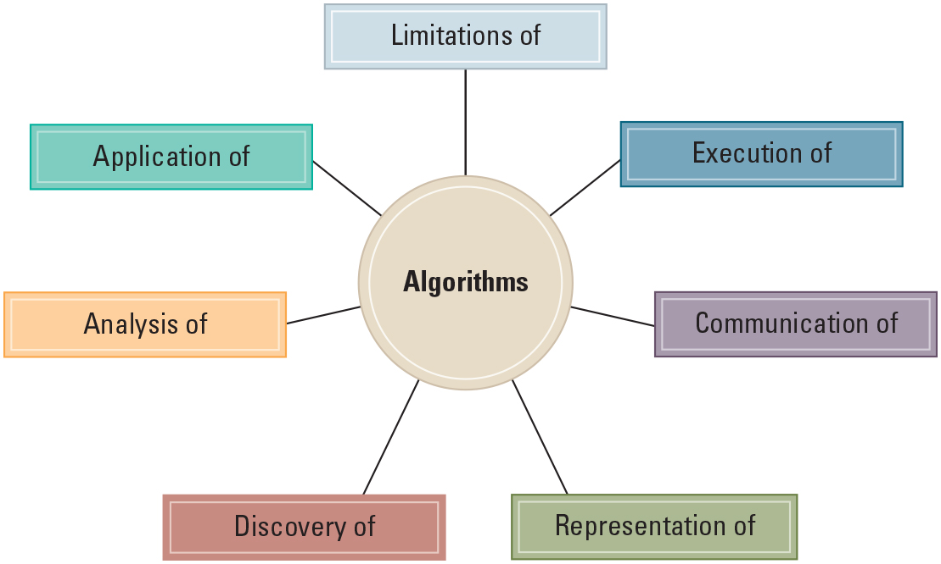
Figure 3 The central role of algorithms in computer science

Slide 16
Given the Central Role of Algorithms
Which problems can be solved by algorithmic processes?
Virtually all, but consider what Gödel's Incompleteness Theorem says – there is still work to be done to perfect areas such as game theory, AI+ML, text searching, resource threading, dealing with really large numbers.
How can characteristics of different algorithms be analyzed and compared?
Computational complexity – time, storage, other resource usage and load.
How can algorithms be applied to produce intelligent behavior?
How does the application of algorithms affect society?

Slide 17
Given the Central Role of Algorithms
How can algorithms be applied to produce intelligent behavior?
AI+ML applications
Natural Language Processing,
Perception (Speech/Facial/Object Recognition)
Motion/Manipulation (Robotics)
Social Intelligence (think Alexa, Cortana, Siri)
How does the application of algorithms affect society?
Everyday non-computer related, routine tasks (brushing teeth, making a sandwich)
Help manage information overload (search filtering).
IoT – Internet of Things (Smart Homes, Digitized Healthcare, Manufacturing and Agricultural applications)

Slide 18
Abstraction
Abstraction: The distinction between the external properties of an entity and the details of the entity’s internal composition
Abstract tool: A “component” that can be used without concern for the component’s internal properties
One example: RPGs
Intention: Making a plan of one’s own creation in response to the current situation in the game world and one’s understanding of the game play options.
Perceivable Consequence: A clear reaction from the game world to the action of the player.
Others: Combat, Cooperation, Conflict, Confusion

Slide 19
Creativity
Computer science is inherently creative
Discovering and applying algorithms is a human activity
Extends existing forms of expression
Enables new modes of digital expression
Creating large software systems is like conceiving a grand new sculpture or like architecting and building a new house.

Slide 20
Data
Computers can represent any information that can be discretized (shown in a discrete quantity) and digitized
Algorithms process and transform data
Search for patterns
Create simulations
Generate knowledge and insight
Data is driving modern discovery – many companies are centralizing IT departments around data as their most valuable asset and resource and the new trend is to view “data as a product”.

Slide 21
Questions about Data
How do computers store data about common digital artifacts?
Data Types - Numbers, Text/String, Boolean, Images, Sounds, Video (BLOB objects and file types)
How do computers approximate data about analog artifacts in the real world?
Analog: ex.-sound waves (not represented by numbers)
Digital: represented by series of 0s and 1s
ADC/DAC – Analog-to-Digital / Digital-to-Analog Converter
Examples – Speakers, Headphones, MP3 players
Data is stored as digital, but a ADC/DAC converts it to sound that can be heard and understood

Slide 22
Questions about Data
How do computers detect and prevent errors in data?
A number of different methods:
Parity Check and Parity Block
Checksum and Check Digit
Automatic Repeat Requests
Echo Check
ref: https://www.computerscience.gcse.guru/theory/error-detection
What are the ramifications or an ever-growing and interconnected universe of digital data?
Security, Privacy concerns (ex. – cloud computing, Big Data)
Digital Divide and Inequality (nations, individuals)

Slide 23
Programming
Programming is broadly referred to as:
Translating human intentions into executable algorithms
Computer hardware is capable of only simple algorithmic steps
Abstractions in a programming language allow humans to reason and encode solutions to complex problems

Slide 24
Questions about Programming
How are programs built?
Software Development Life Cycle (SDLC)
What kind of errors can occur in programs?
Logic Errors, Runtime Errors, Syntax Errors
How are errors in programs found and repaired?
Unit Testing, QA Testing, Regression Testing, Automated Testing

Slide 25
Questions about Programming
What are the effects of errors in modern programs?
Financial, Statistical, Legal
How are programs documented and evaluated?
Code commenting, User manuals, Document Governance
Evaluation: Criteria-based – focuses on quantitative assessment in terms of sustainability, maintainability, and usability.
Example: https://software.ac.uk/sites/default/files/SSI-SoftwareEvaluationCriteria.pdf?_ga=2.175681890.1397792350.1628994929-1993141934.1628994929
Tutorial-based – focuses on usability of software in the form of a set of user experiences.
Example: https://software.ac.uk/sites/default/files/SSI-SoftwareEvaluationTutorial.pdf?_ga=2.151043705.1397792350.1628994929-1993141934.1628994929

Slide 26
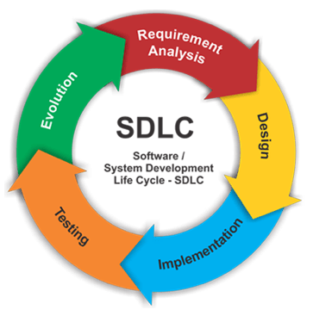
Deployment and Maintenance
Coding and Database Creation

Slide 27
Internet
Profound impact in the way information is:
Stored
Retrieved
Shared
Privacy
Security

Slide 28
Impact
Social, ethical, legal impacts including:
Security concerns
Issues of software ownership and liabilities
Social impact of database technology
Consequences of artificial intelligence

Slide 29
Impact explored through “Social Issues” questions
Social Issues questions are meant to increase awareness of:
Various stakeholders
Alternatives
Short term and long term consequences
Character-based ethics
“Who do I want to be?” “What is the most morally desirable goal for all involved?”
Helps us to become more aware, insightful, and sensitive to the issues involved.

Slide 30
Lesson 1 – Week’s Activities
Complete Course Entry Quiz and Academic Integrity Quiz.
Go through Getting Started and Course Resources pages on Blackboard site.
Post to Class Introductions forum.
Read Chapter 0 in textbook.
Install PyCharm IDE – Course Resources page
Installing Python Tutorial (part of Lab 1)
Using Python Tutorial (part of Lab 1)
Complete Lab 1 (see due date on Course Schedule)

